Slide 1

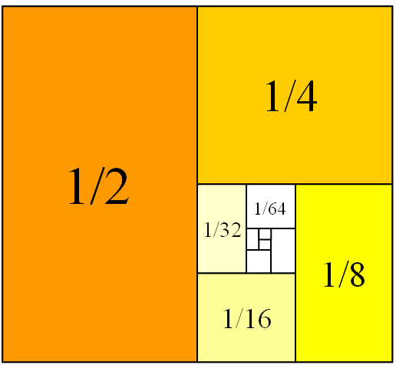
Mathematics for Engineering: Calculus
Chapter 3: DERIVATIVES
Department of Mathematics, FPT University

Slide 2
DERIVATIVES
3.1
Defining the Derivatives
In this section, we will learn:
How the derivative can be interpreted as a rate
of change in any of the sciences or engineering.
Notes:
The slope of tangent line as the limit of slopes of secant lines
Physical examples of instantaneous rates of change and their unit.
The derivative notation f’(a) and meaning of its.
Using f’ to write an equation of the tangent line to a curve at a given point.
Using f’ as an approximate rate of change when working with discrete data.

Slide 3
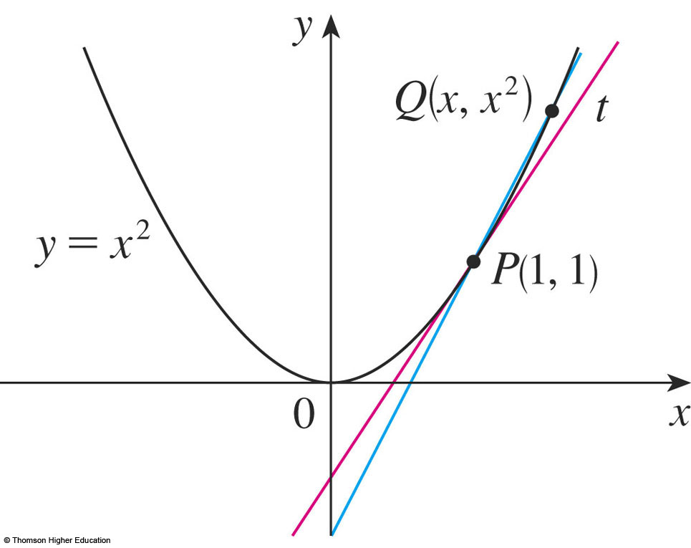
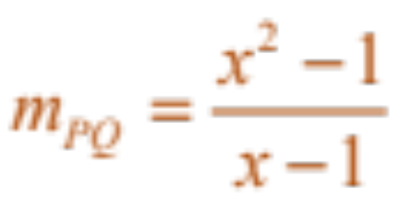
THE TANGENT PROBLEM
Example 1
  Find an equation of the tangent line to the parabola
  y = x² at the point P(1,1).
    We will be able to find an equation of the tangent line as soon as we know its slope m.
Notes:
The slope of tangent line as the limit of slopes of secant lines
m=tanα=tan(PQ,Ox)

Slide 4
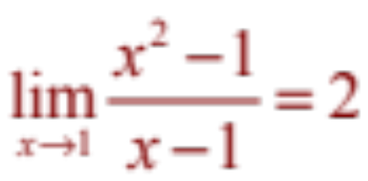
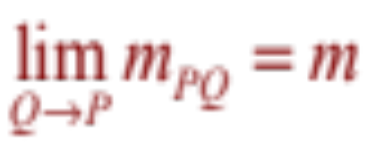
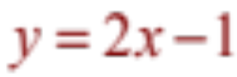
THE TANGENT PROBLEM
Example 1
The slope of the tangent line is said to be the limit of the slopes of the secant lines.
  The equation of the tangent line through (1, 1) as:

Slide 5
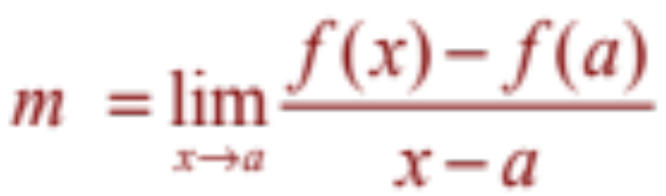
TANGENTS
Definition
The tangent line to the curve y = f(x) at the point P(a, f(a)) is the line through P with slope
provided that this limit exists.

Slide 6

THE VELOCITY PROBLEM
Example 2
  Investigate the example of a falling ball.
    Suppose that a ball is dropped
    from the upper observation
    deck of the CN Tower in
    Toronto, 450 m above the
    ground.
    Find the velocity of the ball
    after 5 seconds.
Notes:
Instantaneous velocity

Slide 7
THE VELOCITY PROBLEM
Example 2
If the distance fallen after t seconds is denoted by s(t) and measured in meters, then Galileo’s law is expressed by the following equation.
s(t) = 4.9t²
Notes:
s(t) = 0,5 g.t²

Slide 8
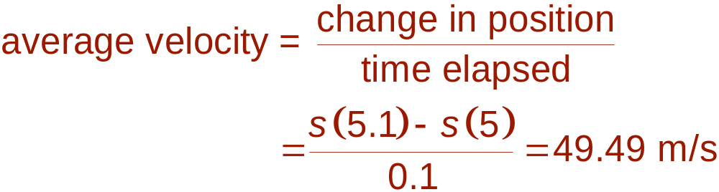
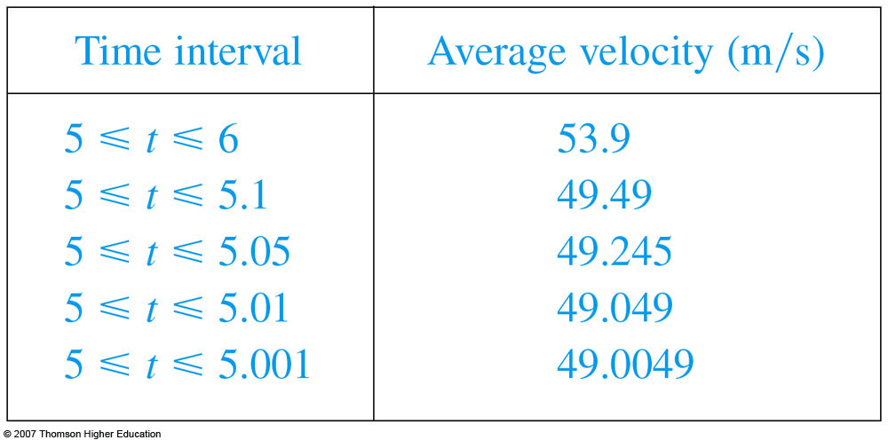
THE VELOCITY PROBLEM
  Thus, the (instantaneous)
  velocity after 5 s is:
  v = 49 m/s

Slide 9
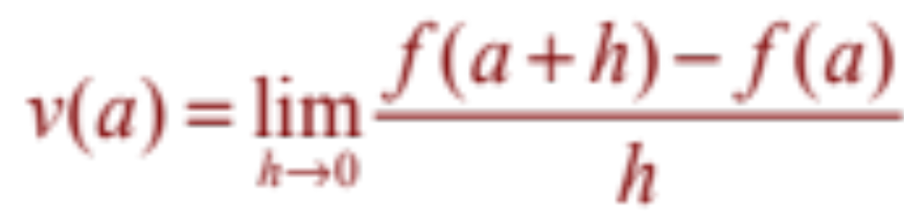
VELOCITIES
Definition
We define the velocity (or instantaneous velocity) v(a) at time t = a to be the limit of these average velocities:
Notes:
What is f(x)?

Slide 10
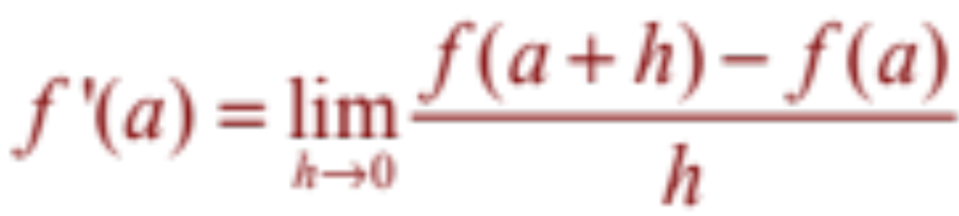
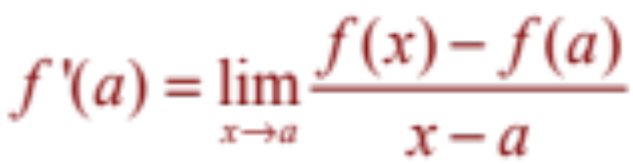
DERIVATIVES
Definition
The derivative of a function f at a number a, denoted by f’(a), is:
if this limit exists. Or
Notes:
Meaning of f’(a)?

Slide 11
DERIVATIVES
3.2
The Derivative as a Function
Notes:
The concept of a differentiable function interpreted graphically, algebraically and descriptive.
Obtaining the derivative function f’ by first considering the derivative at a point a and then a:= a variable such as x.
How a function can fail to be differentiable.
Second and higher derivatives.

Slide 12

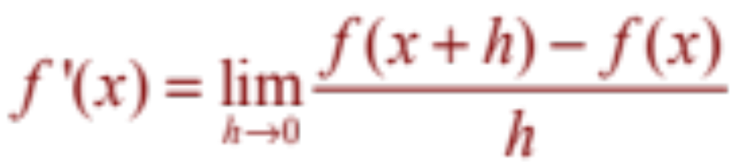
DERIVATIVES
In the preceding section, we considered the derivative of a function f at a fixed number a:
If we replace a in Equation 1 by a variable x, we obtain:
Notes:
f‘(a) is a number; f’(x) is a function

Slide 13
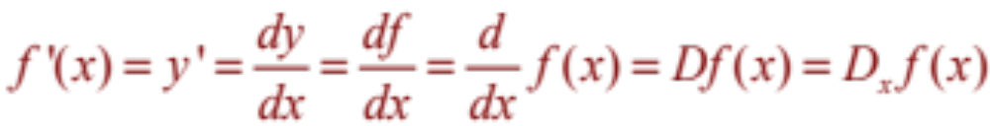
OTHER NOTATIONS
Some common alternative notations for the derivative are as follows:
The symbols D and d/dx are called differentiation operators.
The symbol dy/dx is called Leibniz notation

Slide 14
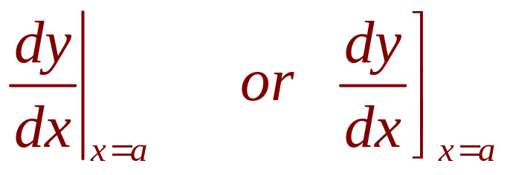
OTHER NOTATIONS
If we want to indicate the value of a derivative dy/dx in Leibniz notation at a specific number a, we use the notation
which is a synonym for f’(a).

Slide 15
OTHER NOTATIONS
Definition
A function f is differentiable at a if f’(a) exists.
It is differentiable on an open interval D if it is differentiable at every number in the interval D.

Slide 16
HOW CAN A FUNCTION FAIL TO BE DIFFERENTIABLE?
Theorem
If f is differentiable at a,
then f is continuous at a.
This theorem states that, if f is not continuous at a, then f is not differentiable at a.
Notes:
“<=“ is false: y = |x| is continuous at 0 but it is not differentiable at 0.

Slide 17
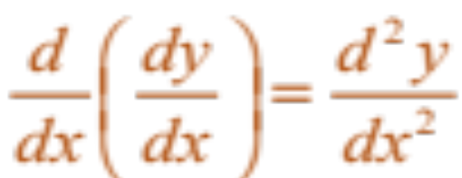
HIGHER DERIVATIVES
If f is a differentiable function, then its derivative f’ is also a function.
So, f’ may have a derivative of its own, denoted by
(f’)’= f’’.
This new function f’’ is called the second derivative of f.

Slide 18
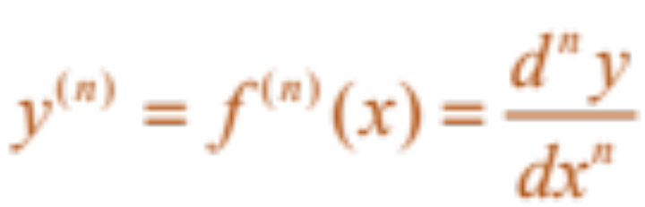
HIGHER DERIVATIVES
The process can be continued.
  In general, the nth derivative of f is denoted by f^{(n)} and is obtained from f by differentiating n times.
  If y = f(x), we write:

Slide 19
DERIVATIVES
3.3 Differentiation Rules
3.5 Derivatives of Trigonometric functions
3.9 Derivatives of Exponential and Logarithmic functions
Notes:
The computation of derivatives using the power, constant multiple, sum, difference, product and quotient rules.
The normal line to a curve at a point.

Slide 20
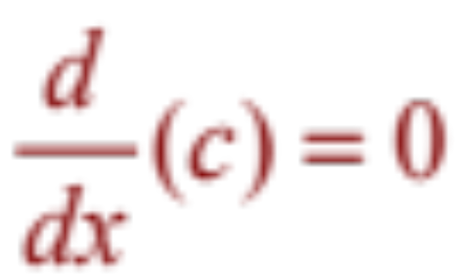
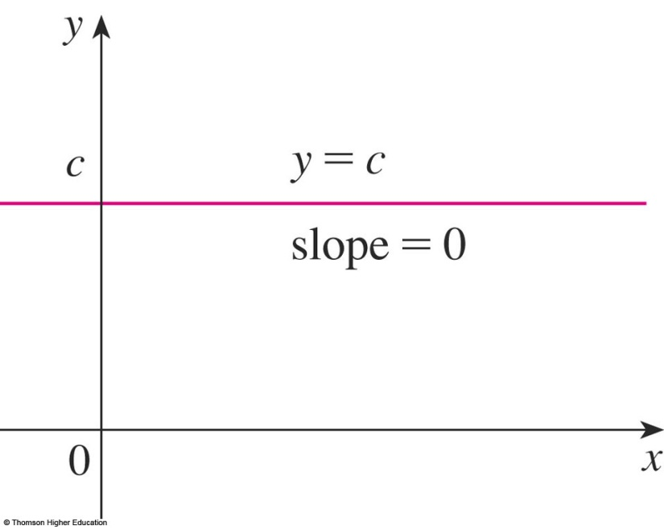
3.3 DIFFERENTIATION RULES
Constant function
In Leibniz notation, we write this rule as follows.
(Reference Pages, p.5)
Notes:
e is constant

Slide 21
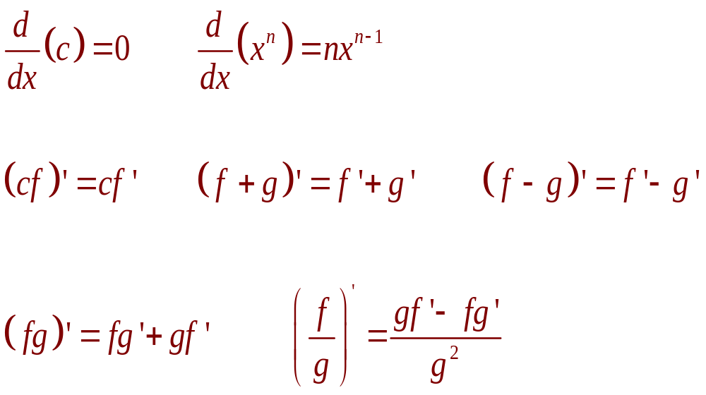
3.3 DIFFERENTIATION RULES
Differentiation formulas
Here’s a summary of the differentiation formulas we have learned so far.

Slide 22

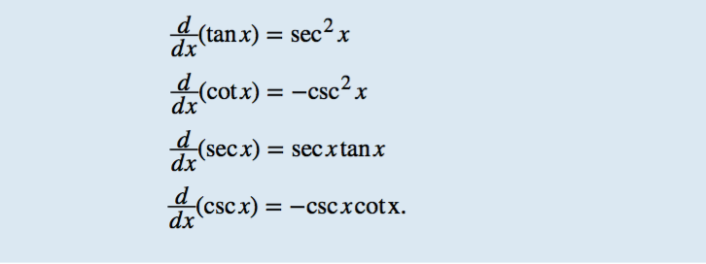
3.5 DERIVATIVES OF TRIGONOMETRIC FUNCTIONS

Slide 23
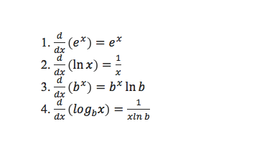
3.9 DERIVATIVES OF EXPONENTIAL AND LOGARITHMIC FUNCTIONS

Slide 24
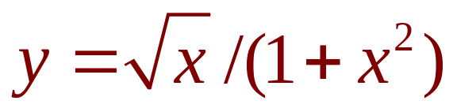

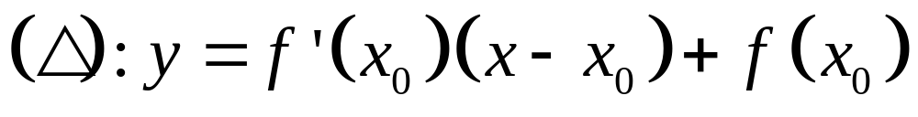
REMARK: Tangent line (Δ) equation at M(x,y) (C): y = f(x)
TANGENT AND NORMAL LINES
Example 12
Find equations of the tangent line and normal line to the curve
at the point (1, ½).
Notes:
The normal line is defined as the line that is perpendicular to the tangent line at the point of tangency.

Slide 25
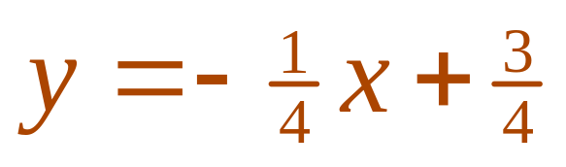
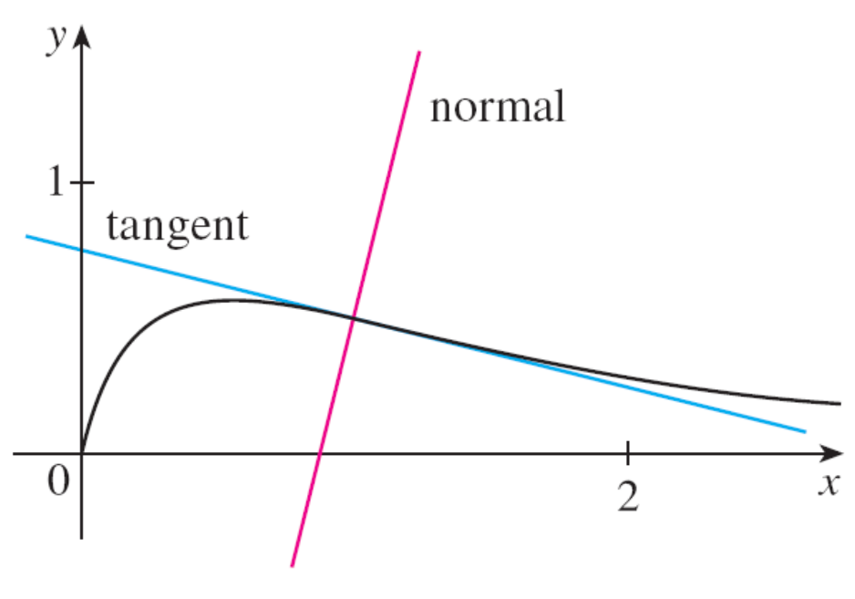
TANGENT AND NORMAL LINES
Tangent line of the graph of this curve at (1,1/2) is:
© Thomson Higher Education

Slide 26
DERIVATIVES
3.4
Derivatives as Rates of change
Notes:
The concept of a differentiable function interpreted graphically, algebraically and descriptive.
Obtaining the derivative function f’ by first considering the derivative at a point a and then a:= a variable such as x.
How a function can fail to be differentiable.
Second and higher derivatives.

Slide 27
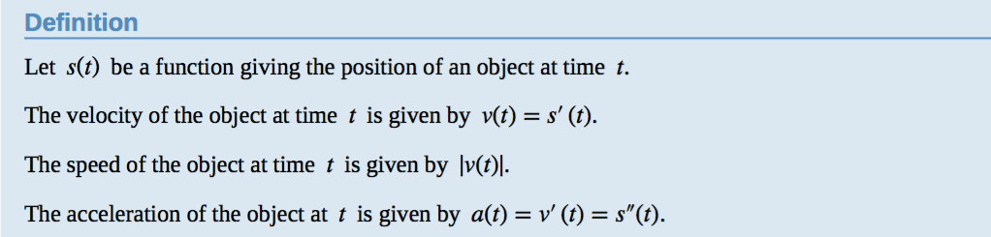
DERIVATIVES
Notes:
The concept of a differentiable function interpreted graphically, algebraically and descriptive.
Obtaining the derivative function f’ by first considering the derivative at a point a and then a:= a variable such as x.
How a function can fail to be differentiable.
Second and higher derivatives.

Slide 28
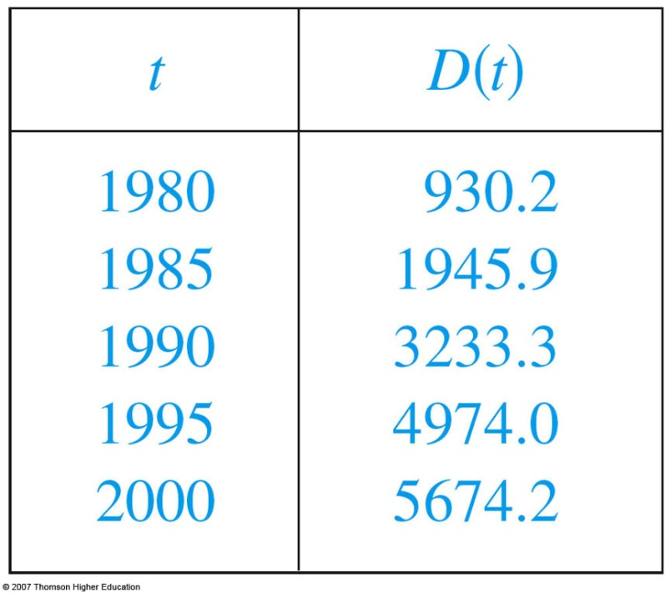
RATES OF CHANGE
Example
Let D(t) be the US national debt at time t. The table gives approximate values of this function by providing end-of-year estimates, in billions of dollars, from 1980 to 2000.
Interpret and estimate the value of D’(1990).
The derivative D’(1990) means the rate of
change of D with respect to t when t =1990,
that is, the rate of increase of the national
debt in 1990.
Notes:
Using f’ as an approximate rate of change when working with discrete data.

Slide 29
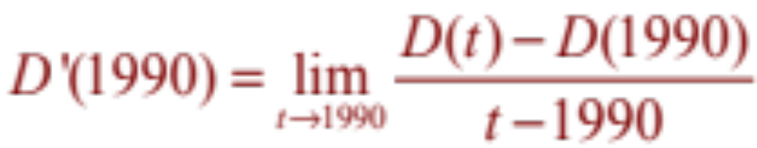
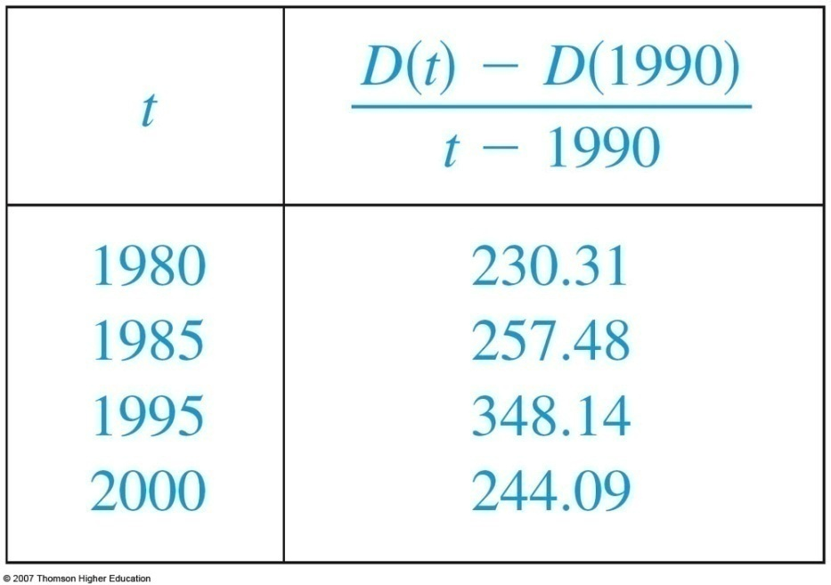

RATES OF CHANGE
Example
By Equation 5,
So, we compute and tabulate values of the difference quotient as follows.
Notes:
Using f’ as an approximate rate of change when working with discrete data.

Slide 30


RATES OF CHANGE
Example
We estimate that the rate of increase of
the national debt in 1990 was the average of
these two numbers—namely
billion dollars per year.

Slide 31
DERIVATIVES
3.6
The chain rule
Notes:
The concept of a differentiable function interpreted graphically, algebraically and descriptive.
Obtaining the derivative function f’ by first considering the derivative at a point a and then a:= a variable such as x.
How a function can fail to be differentiable.
Second and higher derivatives.

Slide 32
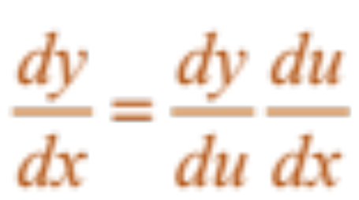
THE CHAIN RULE
If g is differentiable at x and f is differentiable at g(x), the composite function F = f ◦ g is differentiable at x and F’ is given by the product:
F’(x) = f’(g(x)) • g’(x)
  In Leibniz notation, if y = f(u) and u = g(x) are both differentiable functions, then:
Notes:
dy/dx is y’ dependent on x
dy/du is y’ dependent on u
du/dx is u’ dependent on x
“/” is not division.

Slide 33
Let f(x)=g(sin3x). Find f’ in terms of g’.
A | 3cos3xg’(x)
B | 3cos3xg’(sin3x)
C | cos3xg’(sin3x)
Answer: b

Slide 34
Suppose h(x)=f(g(x)) and f(2)=3, g(2)=1, g’(2)=1, f’(2)=2, f’(1)=5. Find h’(2).
A | 1
B | 2
C | 3
D | 4
E | 5
Answer: e

Slide 35
DERIVATIVES
3.6
Implicit Differentiation
Notes:
The concept of a differentiable function interpreted graphically, algebraically and descriptive.
Obtaining the derivative function f’ by first considering the derivative at a point a and then a:= a variable such as x.
How a function can fail to be differentiable.
Second and higher derivatives.

Slide 36
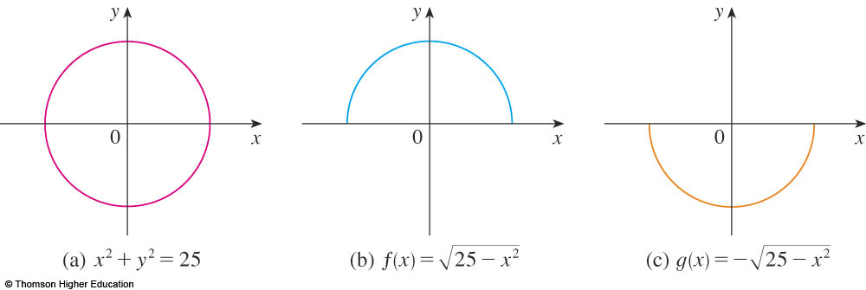
IMPLICIT DIFFERENTIATION
The graphs of f and g are the upper and lower semicircles of the circle
x² + y² = 25.
Notes:
What is implicit function?
The technique of implicit differentiation

Slide 37
IMPLICIT DIFFERENTIATION METHOD
Instead, we can use the method of implicit differentiation.
  This consists of differentiating both sides of the equation with respect to x and then solving the resulting equation for y’.

Slide 38
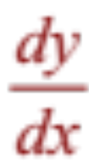
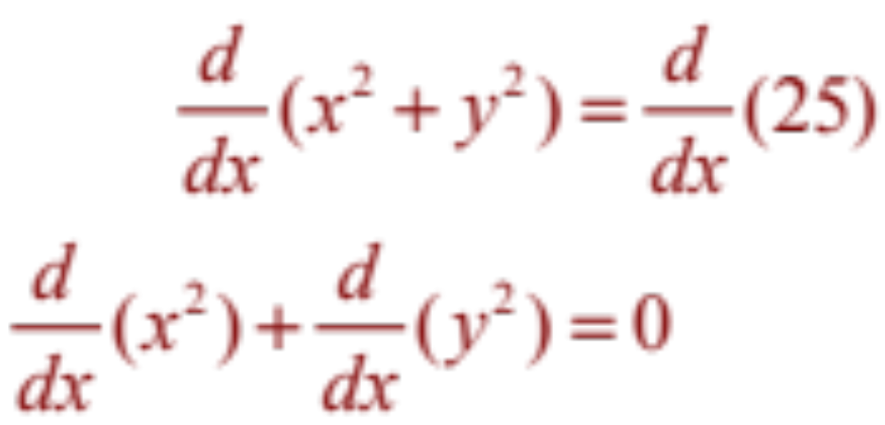
IMPLICIT DIFFERENTIATION
Example 1
a. If x² + y² = 25, find .
b. Find an equation of the tangent to the circle x² + y² = 25 at the point (3, 4).

Slide 39
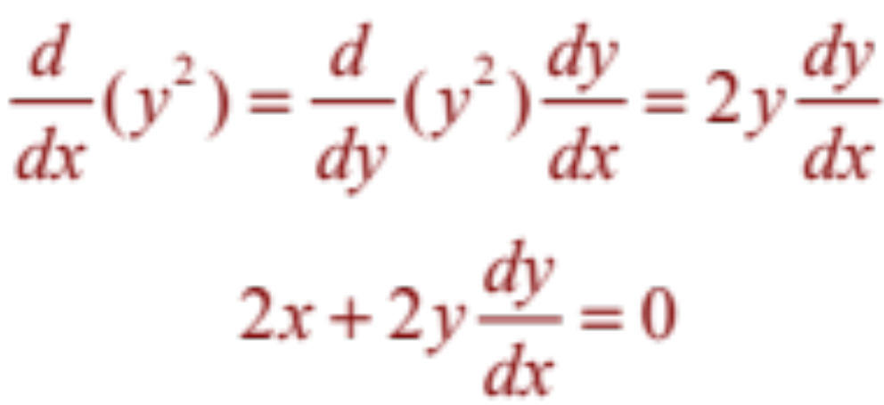

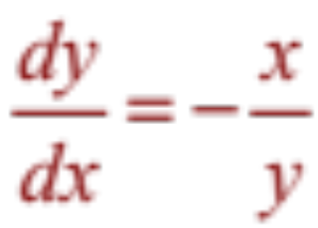
IMPLICIT DIFFERENTIATION
Example 1 a
Remembering that y is a function of x and using the Chain Rule, we have:
Then, we solve this equation for :

Slide 40
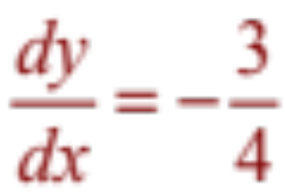
IMPLICIT DIFFERENTIATION
E. g. 1 b—Solution 1
At the point (3, 4) we have x = 3 and y = 4.
So,
  Thus, an equation of the tangent to the circle at (3, 4)
  is: y – 4 = – ¾(x – 3) or 3x + 4y = 25.

Slide 41
IMPLICIT DIFFERENTIATION
Example 4
Find y” if x⁴ + y⁴ = 16.
Differentiating the equation implicitly with respect to x, we get 4x³ + 4y³y’ = 0.

Slide 42
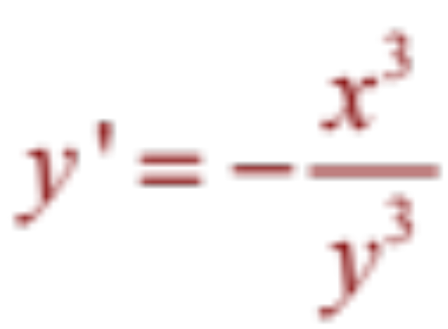
IMPLICIT DIFFERENTIATION
E. g. 4—Equation 3
Solving for y’ gives:

Slide 43
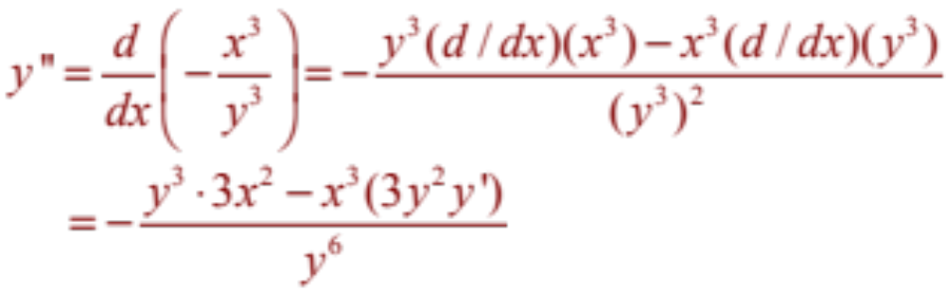
IMPLICIT DIFFERENTIATION
Example 4
To find y’’, we differentiate this expression
for y’ using the Quotient Rule and remembering that y is a function of x:

Slide 44
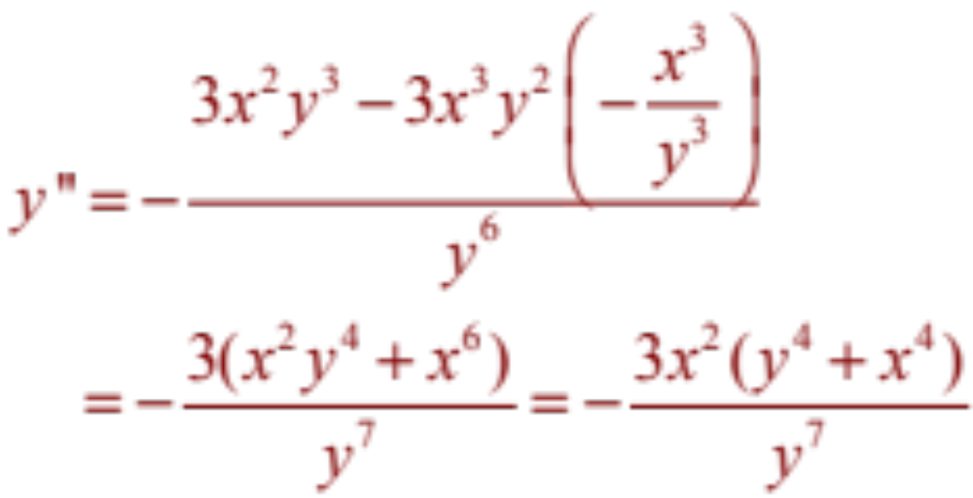
IMPLICIT DIFFERENTIATION
Example 4
If we now substitute Equation 3 into
this expression, we get:

Slide 45
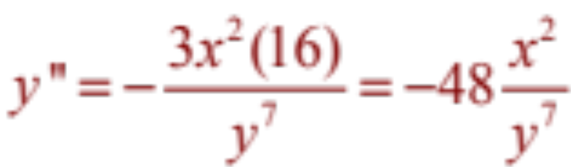
IMPLICIT DIFFERENTIATION
Example 4
However, the values of x and y must satisfy the original equation x⁴ + y⁴ = 16.
So, the answer simplifies to:

Slide 46
Thanks

